Slide 1
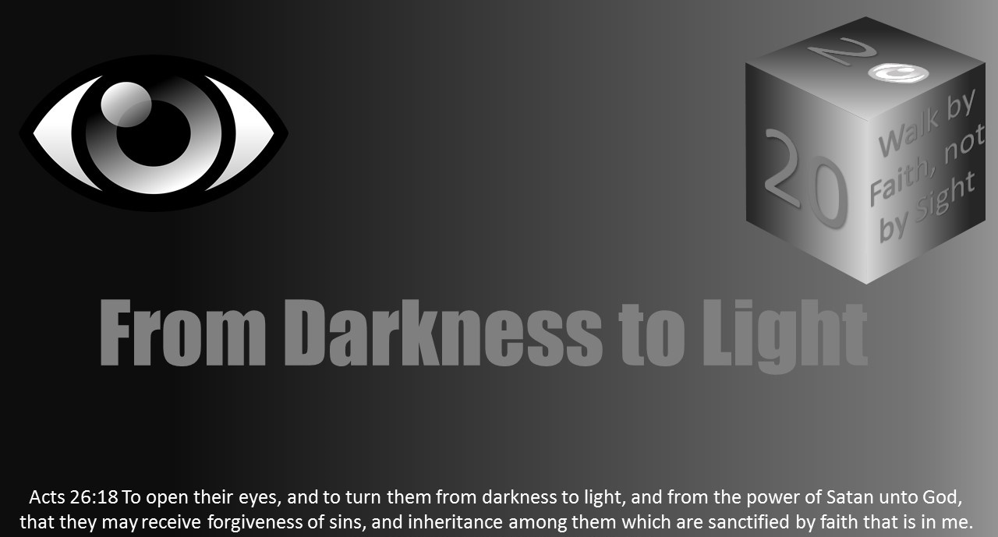


Slide 2

A Christian Is The Light Of The World

Slide 3
A Christian Is The Light Of The World
Jesus Was The Light Of This World

Slide 4
John 1:1-9 NKJV
¹ In the beginning was the Word, and the Word was with God, and the Word was God. ² He was in the beginning with God. ³ All things were made through Him, and without Him nothing was made that was made. ⁴ In Him was life, and the life was the light of men. ⁵ And the light shines in the darkness, and the darkness did not comprehend it.

Slide 5
John 1:1-9 NKJV
⁶ There was a man sent from God, whose name was John. ⁷ This man came for a witness, to bear witness of the Light, that all through him might believe. ⁸ He was not that Light, but was sent to bear witness of that Light. ⁹ That was the true Light which gives light to every man coming into the world.

Slide 6
John 8:12 NKJV
¹² Then Jesus spoke to them again, saying, “I am the light of the world. He who follows Me shall not walk in darkness, but have the light of life.”

Slide 7
A Christian Is The Light Of The World
Jesus Was The Light Of This World

Slide 8
A Christian Is The Light Of The World
Jesus Was The Light Of This World
Jesus’ life was a bold contrast to the world

Slide 9
Revelation 4:8 NKJV
⁸ The four living creatures, each having six wings, were full of eyes around and within. And they do not rest day or night, saying: “Holy, holy, holy, Lord God Almighty, Who was and is and is to come!”

Slide 10
1 John 1:5 NKJV
⁵ This is the message which we have heard from Him and declare to you, that God is light and in Him is no darkness at all.

Slide 11
1 John 2:16 NKJV
¹⁶ For all that is in the world—the lust of the flesh, the lust of the eyes, and the pride of life—is not of the Father but is of the world.

Slide 12
John 3:19-21 NKJV
¹⁹ And this is the condemnation, that the light has come into the world, and men loved darkness rather than light, because their deeds were evil. ²⁰ For everyone practicing evil hates the light and does not come to the light, lest his deeds should be exposed. ²¹ But he who does the truth comes to the light, that his deeds may be clearly seen, that they have been done in God.”

Slide 13
A Christian Is The Light Of The World
Jesus Was The Light Of This World
Jesus’ life was a bold contrast to the world

Slide 14
A Christian Is The Light Of The World
Jesus Was The Light Of This World
Jesus was the perfect example of righteousness living

Slide 15
Hebrews 4:15 NKJV
¹⁵ For we do not have a High Priest who cannot sympathize with our weaknesses, but was in all points tempted as we are, yet without sin.

Slide 16
A Christian Is The Light Of The World
Jesus Was The Light Of This World
Jesus was the perfect example of righteousness living

Slide 17
A Christian Is The Light Of The World
Jesus Was The Light Of This World
Jesus’ teachings perfectly pointed people to righteousness

Slide 18
A Christian Is The Light Of The World
Jesus Was The Light Of This World
Jesus called His disciples to be the “light of the world”

Slide 19
Matthew 5:13 NKJV
¹³ “You are the salt of the earth; but if the salt loses its flavor, how shall it be seasoned? It is then good for nothing but to be thrown out and trampled underfoot by men.

Slide 20
Matthew 5:14-16 NKJV
¹⁴ “You are the light of the world. A city that is set on a hill cannot be hidden. ¹⁵ Nor do they light a lamp and put it under a basket, but on a lampstand, and it gives light to all who are in the house. ¹⁶ Let your light so shine before men, that they may see your good works and glorify your Father in heaven.

Slide 21
A Christian Is The Light Of The World
Jesus Was The Light Of This World
Jesus called His disciples to be the “light of the world”

Slide 22
A Christian Is The Light Of The World
What It Means To Be The Light Of The World

Slide 23
A Christian Is The Light Of The World
What It Means To Be The Light Of The World
You are holy

Slide 24
1 Peter 1:13-16 NKJV
¹³ Therefore gird up the loins of your mind, be sober, and rest your hope fully upon the grace that is to be brought to you at the revelation of Jesus Christ; ¹⁴ as obedient children, not conforming yourselves to the former lusts, as in your ignorance; ¹⁵ but as He who called you is holy, you also be holy in all your conduct, ¹⁶ because it is written, “Be holy, for I am holy.”

Slide 25
A Christian Is The Light Of The World
What It Means To Be The Light Of The World
You are holy

Slide 26
Ephesians 5:11 NKJV
¹¹ And have no fellowship with the unfruitful works of darkness, but rather expose them.

Slide 27
A Christian Is The Light Of The World
What It Means To Be The Light Of The World
You are holy

Slide 28
A Christian Is The Light Of The World
What It Means To Be The Light Of The World
You stand out from the world

Slide 29
Romans 12:1-2 NKJV
¹ I beseech you therefore, brethren, by the mercies of God, that you present your bodies a living sacrifice, holy, acceptable to God, which is your reasonable service. ² And do not be conformed to this world, but be transformed by the renewing of your mind, that you may prove what is that good and acceptable and perfect will of God.

Slide 30
1 Peter 4:3-4 NKJV
³ For we have spent enough of our past lifetime in doing the will of the Gentiles—when we walked in lewdness, lusts, drunkenness, revelries, drinking parties, and abominable idolatries. ⁴ In regard to these, they think it strange that you do not run with them in the same flood of dissipation, speaking evil of you.

Slide 31
A Christian Is The Light Of The World
What It Means To Be The Light Of The World
You stand out from the world

Slide 32
A Christian Is The Light Of The World
What It Means To Be The Light Of The World
You expose others as being in darkness

Slide 33
John 3:19-20 NKJV
¹⁹ And this is the condemnation, that the light has come into the world, and men loved darkness rather than light, because their deeds were evil. ²⁰ For everyone practicing evil hates the light and does not come to the light, lest his deeds should be exposed.

Slide 34
John 15:18-19 NKJV
¹⁸ “If the world hates you, you know that it hated Me before it hated you. ¹⁹ If you were of the world, the world would love its own. Yet because you are not of the world, but I chose you out of the world, therefore the world hates you.

Slide 35
A Christian Is The Light Of The World
What It Means To Be The Light Of The World
You expose others as being in darkness

Slide 36
A Christian Is The Light Of The World
What It Means To Be The Light Of The World
You serve as a beacon of light for those living in darkness

Slide 37
Matthew 9:36 NKJV
³⁶ But when He saw the multitudes, He was moved with compassion for them, because they were weary and scattered, like sheep having no shepherd.

Slide 38
A Christian Is The Light Of The World
What It Means To Be The Light Of The World
You serve as a beacon of light for those living in darkness

Slide 39
A Christian Is The Light Of The World
Let Your Light So Shine

Slide 40
Matthew 5:16 NKJV
¹⁶ Let your light so shine before men, that they may see your good works and glorify your Father in heaven.

Slide 41
A Christian Is The Light Of The World
Let Your Light So Shine

Slide 42
A Christian Is The Light Of The World
Let Your Light So Shine
Through your speech

Slide 43
A Christian Is The Light Of The World
Let Your Light So Shine
Through your worship

Slide 44
John 4:23-24 NKJV
²³ But the hour is coming, and now is, when the true worshipers will worship the Father in spirit and truth; for the Father is seeking such to worship Him. ²⁴ God is Spirit, and those who worship Him must worship in spirit and truth.”

Slide 45
A Christian Is The Light Of The World
Let Your Light So Shine
Through your worship

Slide 46
A Christian Is The Light Of The World
Let Your Light So Shine
Through your teaching

Slide 47
A Christian Is The Light Of The World
Let Your Light So Shine
Through your service

Slide 48
Romans 12:1 NKJV
¹ I beseech you therefore, brethren, by the mercies of God, that you present your bodies a living sacrifice, holy, acceptable to God, which is your reasonable service.

Slide 49
Galatians 6:10 NKJV
¹⁰ Therefore, as we have opportunity, let us do good to all, especially to those who are of the household of faith.

Slide 50
A Christian Is The Light Of The World
Let Your Light So Shine
Through your service

Slide 51
A Christian Is The Light Of The World
Let Your Light So Shine
Through your character

Slide 52
A Christian Is The Light Of The World
Let Your Light So Shine
Through your habits

Slide 53
1 Thessalonians 5:21-22 NKJV
²¹ Test all things; hold fast what is good. ²² Abstain from every form of evil.

Slide 54
A Christian Is The Light Of The World
Let Your Light So Shine
Through your habits

Slide 55
A Christian Is The Light Of The World
Let Your Light So Shine
Through your clothing

Slide 56
1 Timothy 2:9-10 NKJV
⁹ in like manner also, that the women adorn themselves in modest apparel, with propriety and moderation, not with braided hair or gold or pearls or costly clothing, ¹⁰ but, which is proper for women professing godliness, with good works.

Slide 57
A Christian Is The Light Of The World
Let Your Light So Shine
Through your clothing

Slide 58
A Christian Is The Light Of The World
Let Your Light So Shine
Through your choices

Slide 59
Matthew 6:33 NKJV
³³ But seek first the kingdom of God and His righteousness, and all these things shall be added to you.

Slide 60
A Christian Is The Light Of The World
Let Your Light So Shine
Through your choices

Slide 61
A Christian Is The Light Of The World
Let Your Light So Shine
Through your family

Slide 62
A Christian Is The Light Of The World
Common “Baskets”

Slide 63
Matthew 5:14-16 NKJV
¹⁴ “You are the light of the world. A city that is set on a hill cannot be hidden. ¹⁵ Nor do they light a lamp and put it under a basket, but on a lampstand, and it gives light to all who are in the house. ¹⁶ Let your light so shine before men, that they may see your good works and glorify your Father in heaven.

Slide 64
A Christian Is The Light Of The World
Common “Baskets”

Slide 65
A Christian Is The Light Of The World
Common “Baskets”
Shame

Slide 66
Luke 9:26 NKJV
²⁶ For whoever is ashamed of Me and My words, of him the Son of Man will be ashamed when He comes in His own glory, and in His Father's, and of the holy angels.

Slide 67
Romans 1:15-16 NKJV
¹⁵ So, as much as is in me, I am ready to preach the gospel to you who are in Rome also. ¹⁶ For I am not ashamed of the gospel of Christ, for it is the power of God to salvation for everyone who believes, for the Jew first and also for the Greek.

Slide 68
A Christian Is The Light Of The World
Common “Baskets”
Shame

Slide 69
A Christian Is The Light Of The World
Common “Baskets”
Fear

Slide 70
Matthew 10:28 NKJV
²⁸ And do not fear those who kill the body but cannot kill the soul. But rather fear Him who is able to destroy both soul and body in hell.

Slide 71
A Christian Is The Light Of The World
Common “Baskets”
Fear

Slide 72
A Christian Is The Light Of The World
Common “Baskets”
Peace

Slide 73
A Christian Is The Light Of The World
Common “Baskets”
Indifference

Slide 74
Matthew 12:30 NKJV
³⁰ He who is not with Me is against Me, and he who does not gather with Me scatters abroad.

Slide 75
A Christian Is The Light Of The World
Common “Baskets”
Indifference

Slide 76

A Christian Is The Light Of The World

